Slide 1

Netflix Data Analysis
Presented By
KUSHAL BABU S
Business Analytics

Slide 2
Objectives
To explore and visualize Netflix content data to uncover trends, patterns, and actionable insights using Power BI.
To support data-driven decision-making by analyzing content performance across genres, ratings, release years, and countries.

Slide 3
Data Overview
Netflix dataset covering Movies and TV Shows
6,222 titles across 73 countries
Key attributes: content type, genre, rating, duration, release year, date added, and country
Data was cleaned and transformed to ensure accuracy and consistency for analysis

Slide 4
Tools And Technologies
Power BI – Data visualization and interactive dashboard creation
Power Query – Data cleaning and transformation
DAX – Calculated measures and KPIs
Excel / CSV Dataset – Data source for analysis

Slide 5
Key Insights
Netflix hosts a total of 6,222 titles, indicating a large and diverse content library
Movies (4,263) significantly outnumber TV Shows (1,959), showing a stronger focus on movie-based content
Content is distributed across 73 countries, highlighting Netflix’s strong global presence
The higher proportion of movies suggests faster content expansion and broader audience reach

Slide 6
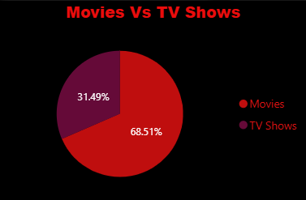
Movies Vs TV Shows
Movies dominate the platform with 68.5% of total content, compared to 31.5% TV shows
Netflix’s strategy is more movie-focused to ensure frequent content additions
TV shows, though fewer, help in long-term viewer engagement

Slide 7
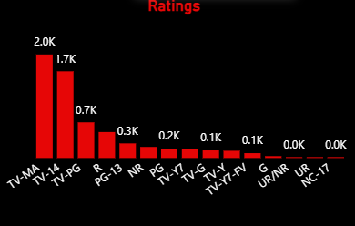
Ratings
TV-MA and TV-14 have the highest number of titles, indicating strong focus on mature and young adult audiences
TV-PG and PG-13 form a moderate portion of the content library
Very limited content is available under G, NC-17, and Unrated categories

Slide 8
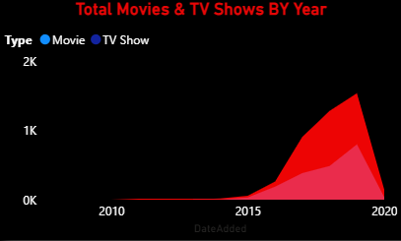
Movies And TV Shows By Years
Netflix content additions remained low until 2014, followed by rapid growth after 2015
A significant surge is observed between 2016 and 2019, reflecting Netflix’s expansion phase
Movies show faster growth compared to TV shows across most years

Slide 9
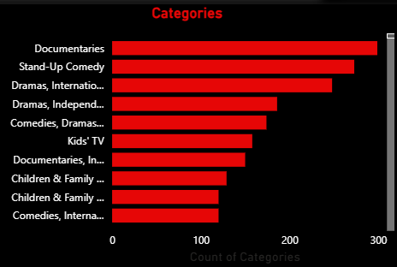
Category Analysis
Documentaries are the most available category on Netflix
Stand-Up Comedy and International Dramas also have high content volume
Netflix places strong emphasis on informative, comedy, and international content
Kids’ TV and Children & Family categories have comparatively fewer titles

Slide 10
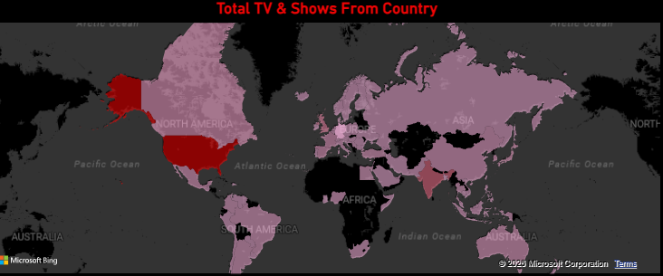
Country-wise Content
The United States contributes the highest number of Netflix titles
Strong content contributions are also observed from India, the UK, and other regions
Netflix content spans across 73 countries, showing a wide global presence
The platform actively invests in regional and localized content to reach diverse audiences

Slide 11
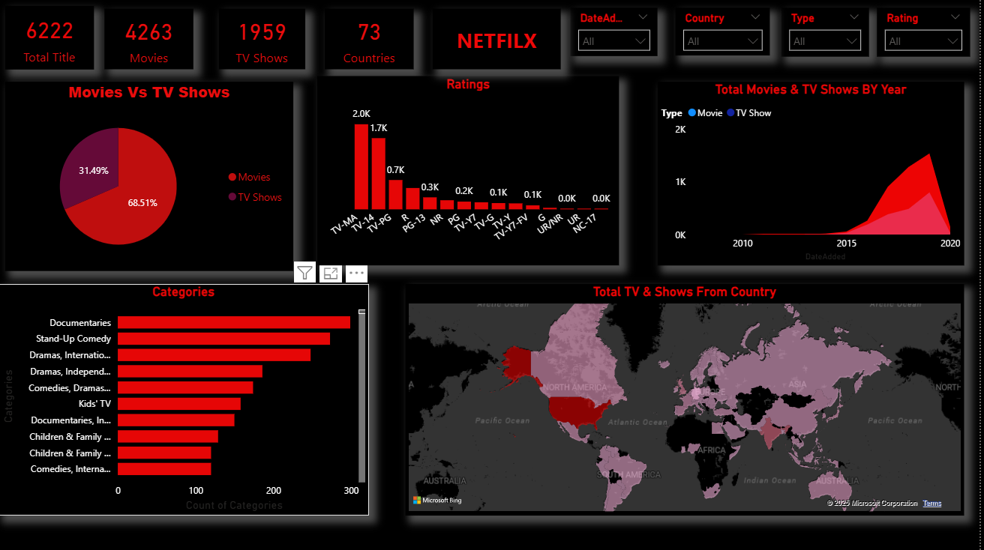
Dash-Board

Slide 12
Overall Insights
Netflix offers 6,222 titles with content spanning 73 countries
Movies dominate the platform, accounting for nearly 70% of total content
Most content targets mature and young adult audiences (TV-MA, TV-14)
Strong growth in content additions observed after 2015, led mainly by movies

Slide 13
Recommendation
Increase investment in high-performing genres such as documentaries, stand-up comedy, and international dramas
Expand regional and localized content to strengthen presence in growing markets
Maintain focus on movie content while gradually increasing quality TV shows for long-term engagement
Balance the content portfolio by adding more family and kids-friendly content

Slide 14
Conclusion
The analysis highlights Netflix’s strong movie-driven and global content strategy
Most content targets mature audiences, with rapid growth after 2015
Netflix shows a clear focus on high-demand genres like documentaries and international content
Power BI helped transform raw data into actionable business insights through interactive visuals
This project strengthened practical skills in data analysis, visualization, and storytelling

Slide 15

THANK YOU

